Slide 1


Optimal Storage Placement and Power Flow Solution
Krishnamurthy
Dvijotham
Yujie Tang
Steven Low
Michael Chertkov
Stanford Nov 2016
Notes:
Power Flow Solution Methods
=========================
July 6, 2016: IEEE ACC Tutorial (Dan Molzahn)
Nov 3, 2016: Stanford Smart Grid Seminars (Ram Rajagopal, Chin-Woo Tan)
Optimal storage placement
=========================
Nov 3, 2016: Stanford Smart Grid Seminars (Ram Rajagopal, Chin-Woo Tan)

Slide 2

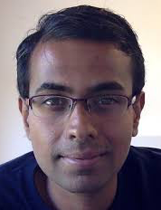
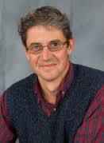






Outline
Optimal storage placement
Continuous network model
Structural properties
Power flow solution
Monotone operators
contraction
contraction
Tang
Dvijotham
Chertkov

Slide 3
Motivation
Storage on distribution network
Useful for renewable/DG integration
CA mandates
RPS: 33% by 2020, 50% by 2030
3 IOUs to deploy 1.3GW battery by 2020
At least ½ owned by IOUs
Design question: ideal deployment ?
Where to place and how to size
... to minimize line loss
... assuming
no other constraints such as real estate
optimal charging/discharging operation

Slide 4
Conclusion
Interested in design guidelines
Structural properties of optimal solution
Placement and sizing
(scaled) Monotone deployment is optimal
Charging/discharging schedule
Always charge till full (when generation is highest)
Always discharge till empty (when demand is highest)

Slide 5
Continuous tree
A continuous tree with underlying discrete tree
Each segment (corresponding to a node in discrete tree) can be treated like a closed interval in R
Order and integration are well defined on each segment
[similar to Wang Turitsyn Chertkov (2012) ODE model of feeder line for power flow solution]

Slide 6
Continuous power flow equations

Slide 7
Continuous power flow equations
line loss
[ power flow equations: continuous version of Baran and Wu (1989) ]

Slide 8
Linear approximation
Assumptions
loss is small relative to line flow
voltage magnitude ~ 1 pu
[ power flow equations: continuous version of Baran and Wu (1989) ]

Slide 9
Linear approximation
Assumptions
loss is small relative to line flow
voltage magnitude ~ 1 pu
charging rate
background injection:
common load shape in time
location-dependent scale & offset
[Smith, Wong, Rajagopal 2012]

Slide 10
Storage model
charging rate
SoC

Slide 11
Optimal placement & sizing
line flow
energy loss
linear power
flow equation
state of charge
budget constraint

Slide 12
Optimal placement & sizing
energy loss
linear power
flow equation
background injection
charging
rate
state of charge
budget constraint

Slide 13
Optimal placement & sizing
energy loss
linear power
flow equation
state of charge
budget constraint

Slide 14
Optimal placement & sizing
energy loss
linear power
flow equation
state of charge
budget constraint

Slide 15
Outline
Optimal storage placement
Continuous network model
Structural properties
Power flow solution
Monotone operators
contraction
contraction
Tang

Slide 16
Linear network
compute:
given:
Theorem Optimal charging schedule
Follow load shape p(t) with an offset, or OFF
Charge when injection is highest till full
Discharge when injection is lowest till empty
charge
net injection is
flat (in time)
discharge
[Tang and Low, CDC 2016]

Slide 17
Linear network
compute:
given:
Theorem Optimal charging schedule
Follow load shape p(t) with an offset, or OFF
Charge when injection is highest till full
Discharge when injection is lowest till empty
charge
flatten net injection
discharge
[Tang and Low, CDC 2016]

Slide 18
Linear network
Theorem Optimal placement & sizing
Deploy most storage far away from substation
Decrease (scaled) storage capacity moving towards substation
... until running out of storage budget
Every node can have distributed generation (2-way power flow)
... as long as all nodes have same load shape (with different scales & offsets)
[Tang and Low, CDC 2016]

Slide 19
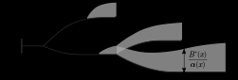
Tree network
Theorem
Structural properties (roughly) extend to tree
optimal placement & sizing

Slide 20
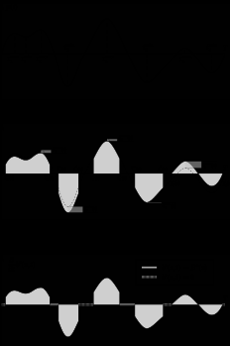
Tree network
Theorem
Structural properties (roughly) extend to tree
charge
till full
discharge
till empty
optimal schedule

Slide 21
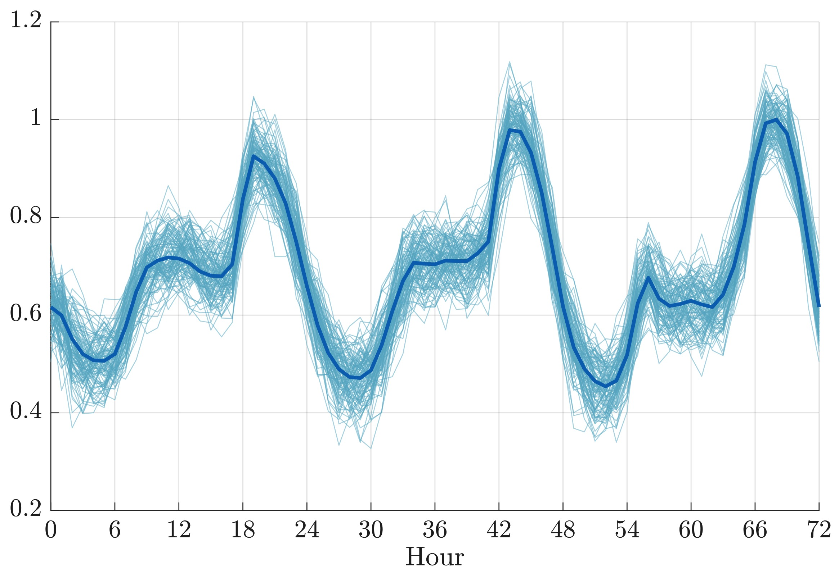
Simulations
IEEE 123-bus test system
More realistic model
Nonlinear DistFlow model
Different nodes have slightly different load shapes (from SCE)
Compare with optimal placement
Monotone property
Total loss
Optimal placement solved using SOCP relaxation of OPF
Notes:
We first show that Theorem 3 holds when p(t) is allowed to have multiple maxima and minima. The load shape shown in Figure 4 is taken from Southern California Edison [19], which consists of load consumptions spanning a 72-hour period, and has multiple peaks and valleys. We employ its negative as p(t), and assume that at bus i, the background injection is given by ↵ip(t), where the scaling factor ↵i is the original load consumption of bus i from the IEEE 123 node test case. To make results clearer, we add a small amount of load to each bus that originally has no load consumption, so that ↵i > 0 and the scaled optimal capacities are well defined for all i. The amount of load added is 1/4 of the smallest original load consumption of a single bus.

Slide 22
Simulations
Optimal placement & sizing from SOCP relaxation of OPF:
Scaled monotone property roughly holds
Notes:
Optimal storage placement for the simplified IEEE 123 node test feeder with nonlinear DistFlow model when p ̃i(t) deviates from the common load shape. The radius of each colored solid circle is proportional to Bi⇤/↵i, and different colors correspond to different Btot.

Slide 23
Simulations
Loss with assumptions (same load shape, linear PF) ~ optimal

Slide 24
Tree network
Theorem
Structural properties (roughly) extend to tree
optimal placement & sizing

Slide 25
Tree network
Theorem
Structural properties (roughly) extend to tree
charge
till full
discharge
till empty
optimal schedule

Slide 26
Outline
Optimal storage placement
Continuous network model
Structural properties
Power flow solution
Monotone operators
contraction
contraction
Dvijotham
Chertkov

Slide 27
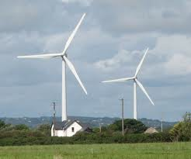
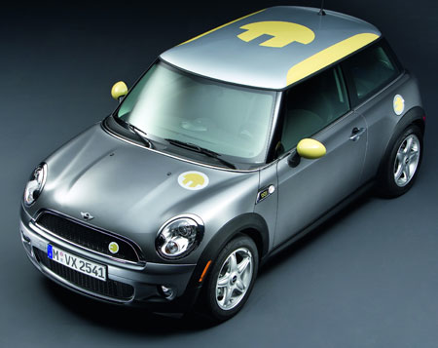
Power flow models
real & reactive power
i
j
k
conductance & susceptance
voltage
phasor
Given s, find V that satisfies

Slide 28
Power flow models
real & reactive power
i
j
k
conductance & susceptance
voltage
phasor
Given (p,q), find (V^{x}, V^{y}) that satisfies

Slide 29
Power flow models
real & reactive power
i
j
k
conductance & susceptance
voltage
phasor
In polar form (can be reparametrized into quadratic equations):

Slide 30
Power flow solutions
Given s, find x that satisfies
where and is quadratic
Different power flow equations lead to different F
Different solution properties
Different computational efficiencies

Slide 31
Power flow solutions
Given s, find x that satisfies
where and is quadratic
Let denote its Jacobian

Slide 32
Power flow solutions
Classical algorithms
Newton-Raphson, Gauss-Seidel, …
Advantage: simple
No guarantee: convergence, solution with desired properties, or all solutions
Homotopy-based algorithms
Can find all PF solutions
Computationally very expensive
Ours: compromise of 2 methods
Characterize PF solution region with desirable properties (operation regime)
Prove there is at most one solution in the region
Fast computation to find the unique solution if exists or certify none exists in the region

Slide 33


Outline
Introduction
Contractive operator method
contraction
contraction

Slide 34
contraction
Let be nonempty, closed, convex, over which
is -strongly positive definite, i.e.
is -bounded, i.e.,
implying F is over D
-strongly monotone
-Lipschitz (because F is quadratic)

Slide 35
contraction
Let be nonempty, closed, convex, over which
is -strongly positive definite, i.e.
is -bounded, i.e.,
implying F is over D
-strongly monotone
-Lipschitz (because F is quadratic)

Slide 36
contraction
Let be nonempty, closed, convex, over which
is -strongly positive definite, i.e.
is -bounded, i.e.,
Theorem
There is at most one PF solution in D
how to efficiently find it if exists, or certify otherwise ?

Slide 37
contraction
Consider
Theorem
is a contraction over with rate
and a unique fixed point
If then is the unique PF solution in D
-approx solution can be computed in
Otherwise, there is no PF solution in D
fixed point iterations

Slide 38
contraction
Consider
Theorem
is a contraction over with rate
and a unique fixed point
If then is the unique PF solution in D
-approx solution can be computed in
Otherwise, there is no PF solution in D
fixed point iterations

Slide 39
contraction
Consider
Theorem
is a contraction over with rate
and a unique fixed point
If then is the unique PF solution in D
-approx solution can be computed in
Otherwise, there is no PF solution in D
fixed point iterations

Slide 40
Solution strategy
Consider
Application
Let be desirable operation regime
Compute s.t. and satisfies conditions 1 and 2 over
Compute
If fixed point then it is the unique desirable PF solution
Otherwise, there is no PF solution in
voltage magnitudes
close to nominal values
line currents
lower than capacities

Slide 41
Solution strategy
Consider
Application
Let be desirable operation regime

Slide 42
Solution strategy
Consider
Application
Let be desirable operation regime
Compute s.t. and satisfies conditions 1 and 2 over
Compute

Slide 43
Solution strategy
Consider
Application
Let be desirable operation regime
Compute s.t. and satisfies conditions 1 and 2 over
Compute
If fixed point and then it is the unique desirable PF solution
Otherwise, there is no PF solution in

Slide 44
Solution strategy
Consider
Application
Let be desirable operation regime
Compute s.t. and satisfies conditions 1 and 2 over
Compute
If fixed point and then it is the unique desirable PF solution
Otherwise, there is no PF solution in

Slide 45
Solution strategy
Consider
Application
Let be desirable operation regime
Compute s.t. and satisfies conditions 1 and 2 over
Compute
If fixed point and then it is the unique desirable PF solution
Otherwise, there is no PF solution in

Slide 46
Enhancement through scaling
Instead of solving
solve, for invertible ,
Maximize monotonicity region by choice of
Optimal W* yields largest monotonicity region

Slide 47
Outline
Introduction
Contractive operator method
contraction
contraction

Slide 48
contraction
Let . Suppose, over ,
is row -diagonally dominant, i.e.
is -bounded, i.e.,
Consider

Slide 49
contraction
Let . Suppose, over ,
is row -diagonally dominant, i.e.
is -bounded, i.e.,
Consider

Slide 50
contraction
Let . Suppose, over ,
is row -diagonally dominant, i.e.
is -bounded, i.e.,
Consider

Slide 51
contraction
Consider
Theorem
is a contraction over with rate
and a unique fixed point
If then is the unique PF solution in D
Otherwise, there is no PF solution in D
Theorem suggests a similar solution strategy

Slide 52
Performance
monotone op method succeeds when Newton-Raphson fails
IEEE 14-bus network
IEEE 39-bus network

Slide 53
Conclusion
PF solution through contraction
Characterize PF solution region with desirable properties
Prove there is at most one solution in the region
Fixed-point iteration computes efficiently…
… either finds the unique solution or certifies none exists in the region

